Slide 1
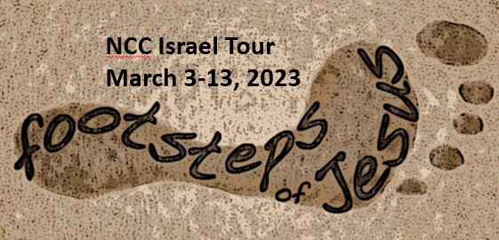
Day by Day

Slide 2
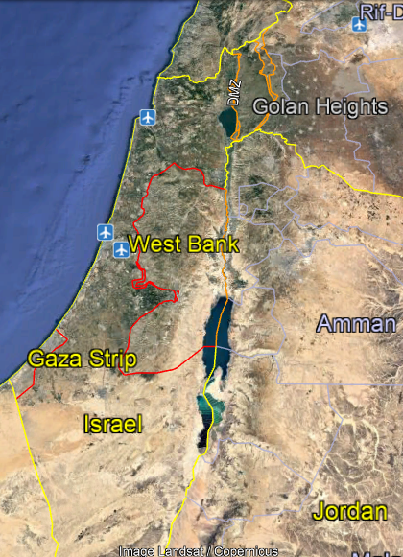
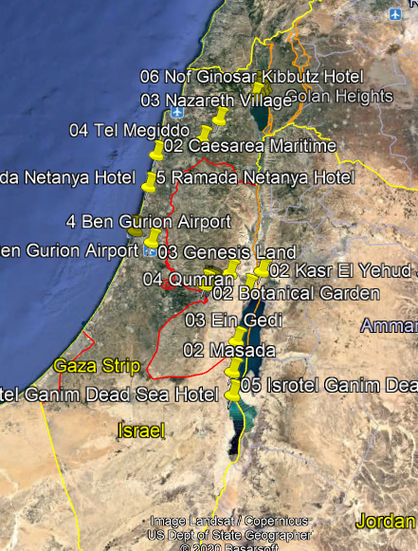
Overview

Slide 3
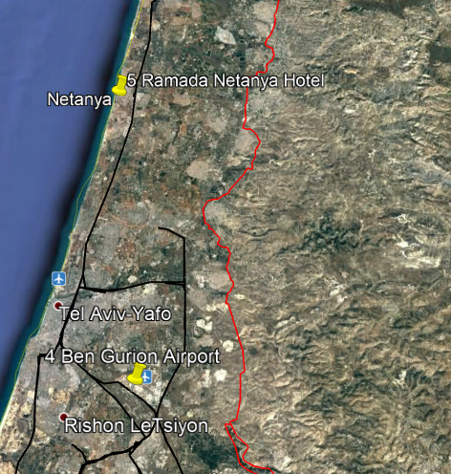
Saturday Day 2

Slide 4
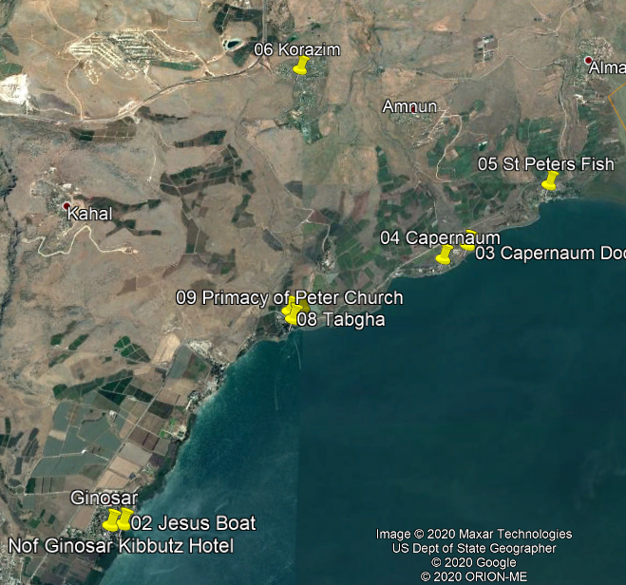
Sunday Day 3

Slide 5
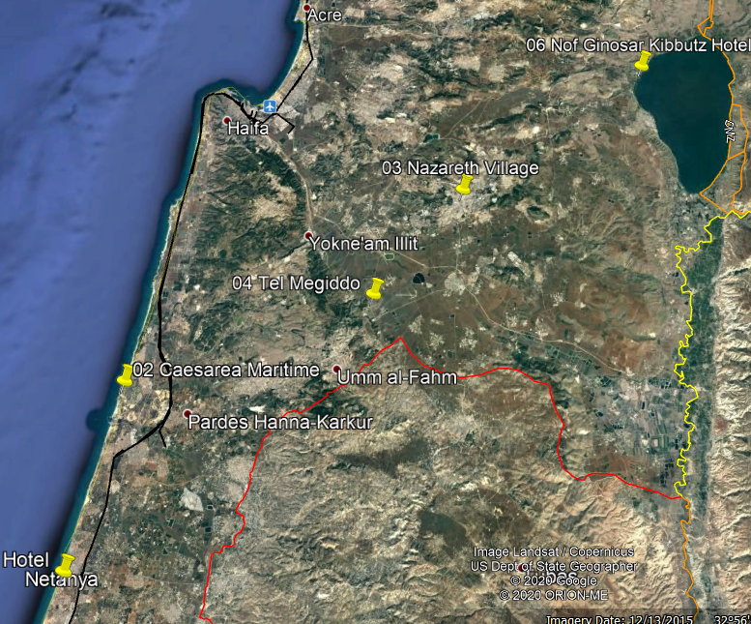
Monday Day 4

Slide 6
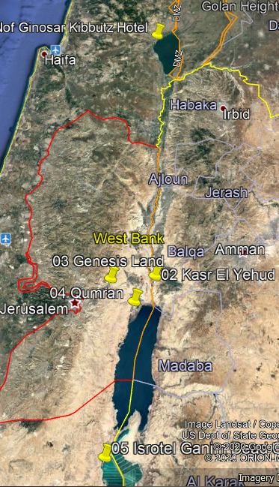
Tuesday
Day 5

Slide 7
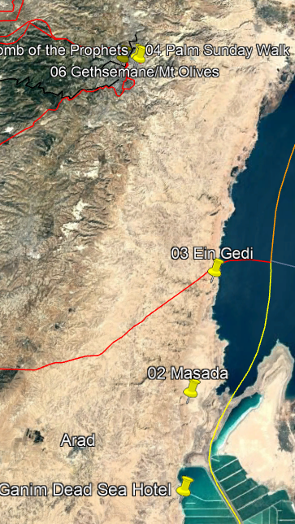
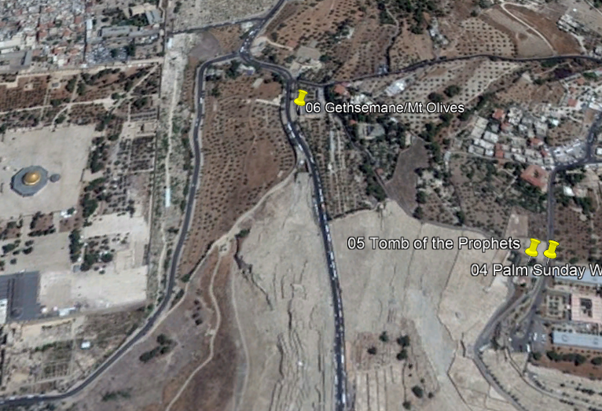
Wednesday
Day 6

Slide 8
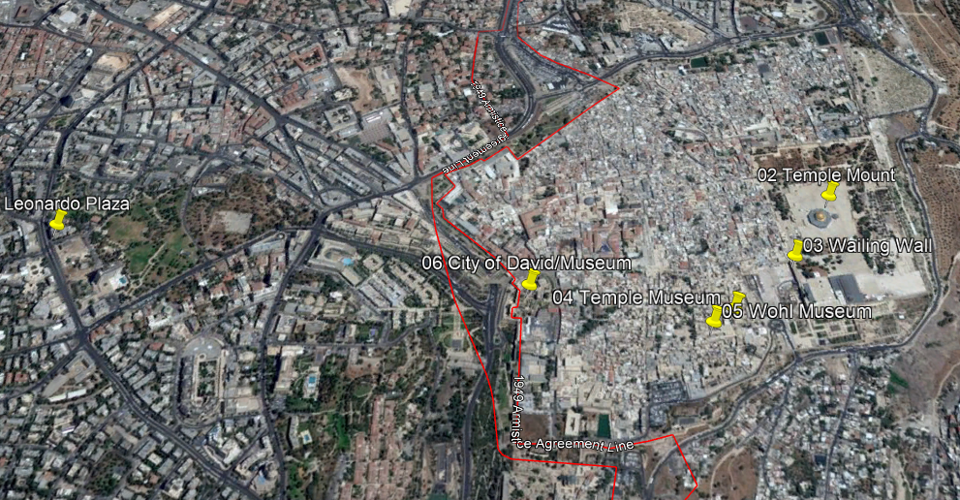
Thursday Day 7

Slide 9
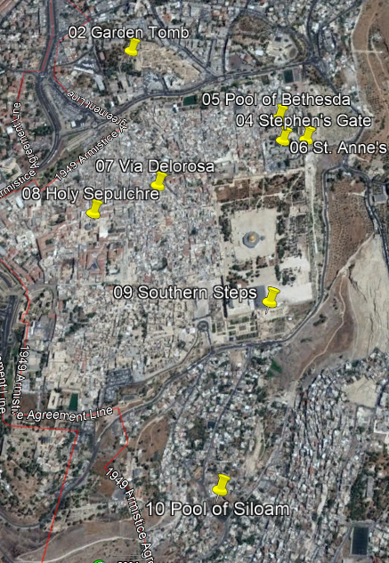
Friday
Day 8

Slide 10
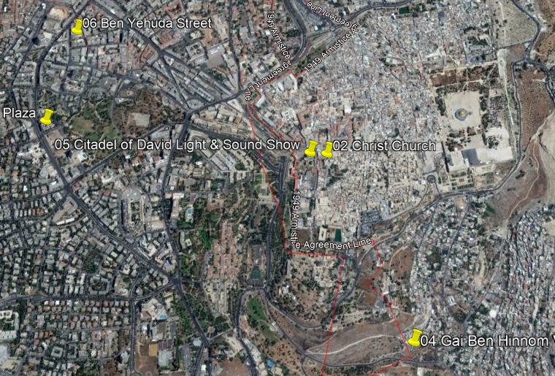
Saturday Day 9

Slide 11
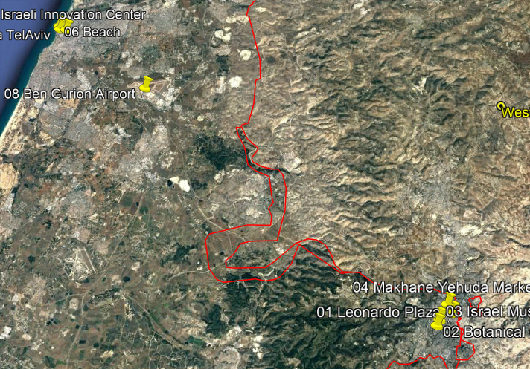
Sunday Day 10 (1 of 2)

Slide 12
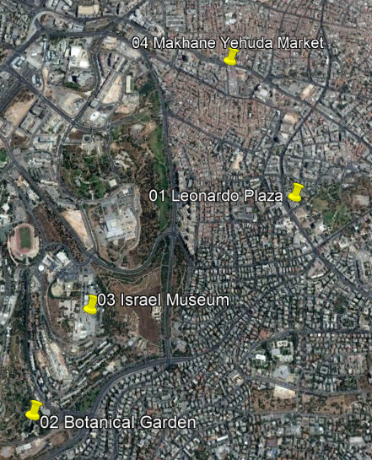
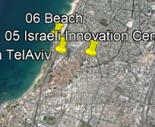
Sunday Day 10 (2 of 2)

Slide 13
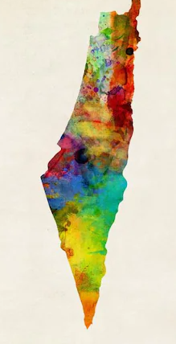
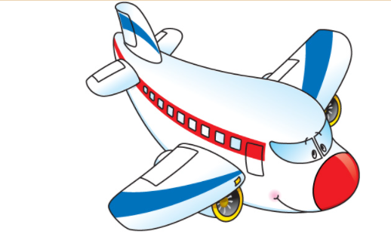
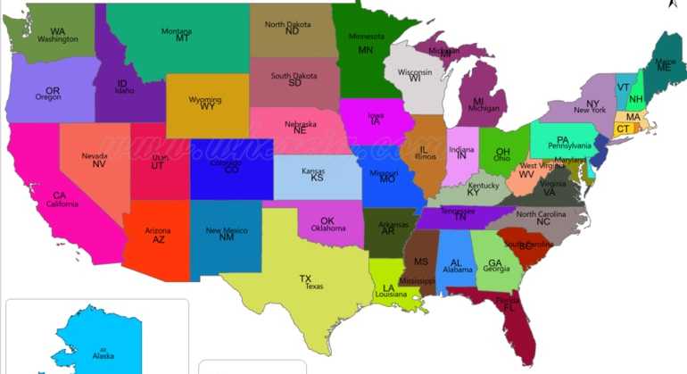
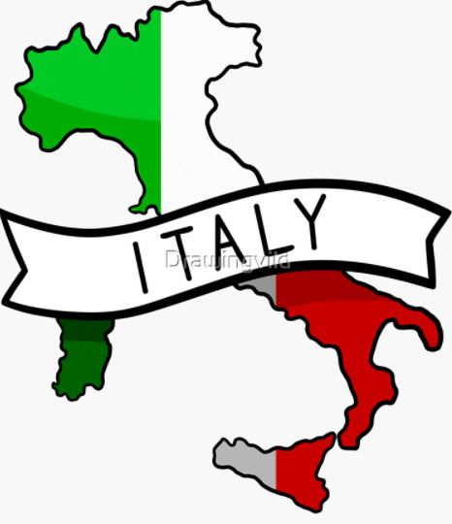
Monday Day 11 (USA or Italy)

Slide 14
Italy Extension
Day 11 March 13 (Mon)
Land Rome Int Airport
Catacombs
Day 12 Rome (Tues)
Roman Forum
Mamertine Prison
Roman Colosseum
Day 13 Rome (Wed)
Vatican Museums
Sistine Chapel
St. Peters Basilica
Scala Santa
St. Paul Outside the Wall
Abbey of Three Fountains
Day 14 Umbria and Assisi (Thur)
Scenic Umbria & Medieval Town
Travel to Florence
Day 15 Florence (Fri)
Academia Galley (Michelangelo’s David
Ponte Vecchio
Shopping & Art Galleries
Rome Int Airport
Day 16 Rome to USA to MCI (Sat)
Warrensburg

Slide 15
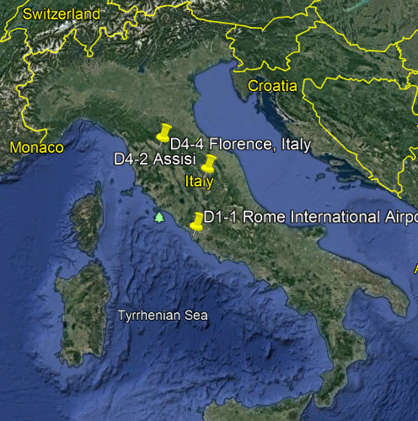
Italy Extension 5 days
(Rome – Florence – Assisi)

Slide 16
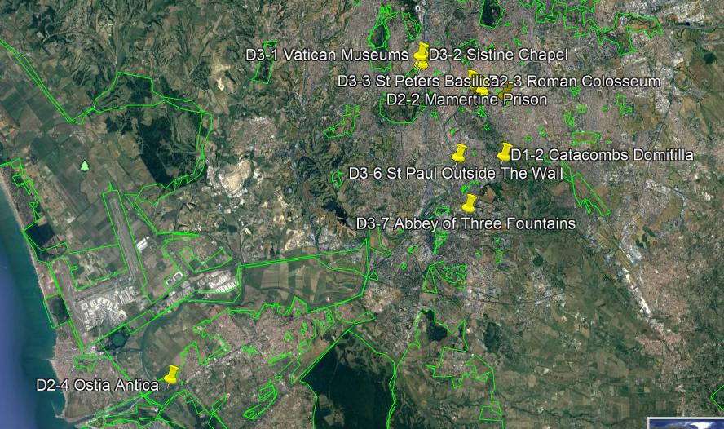
Italy (Rome 3 days)
Monday Day 11 thru Wednesday Day 13

Slide 17
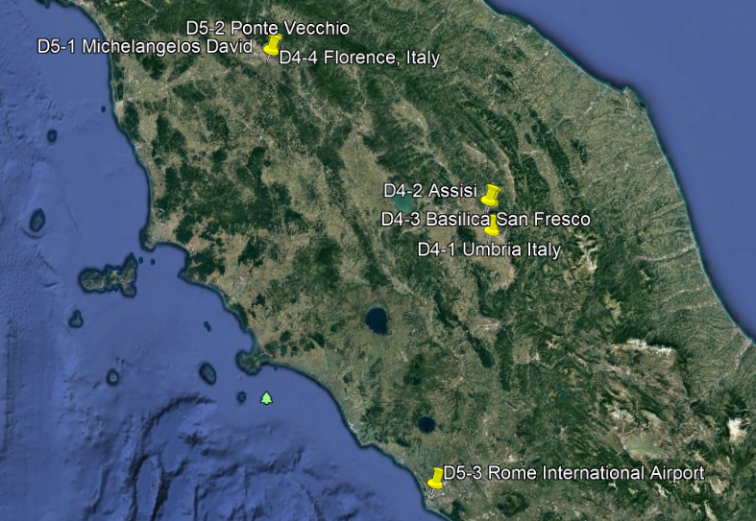
Italy
Assisi (Thursday Day 14) and
Florence (Thursday Day 14 & Friday Day 15)

Slide 18
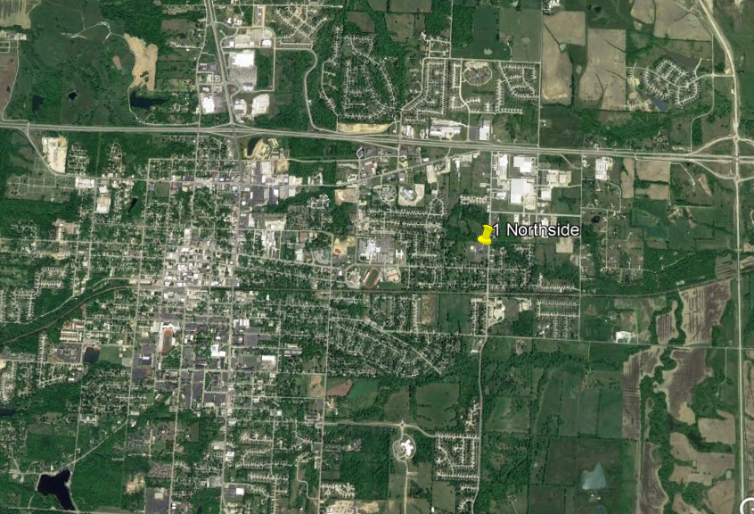
Saturday Day 16

